Slide 1

UNIX
By Md Haque, Ahmed Foysal, Rosario Garcia,Jason Tan , Dariel Baez,Narayan Paudel
Notes:
3 to 4 slides each topics
Capital :
Design. Goals - md haque
Memory Management -rosario
Processor Mangement-
Device Mangement-
File Mangement -
User Inferface-

Slide 2
Let's Talk about Unix:
Most operating systems can be grouped into two different families. Aside from Microsoft’s Windows NT-based operating systems, nearly everything else traces its heritage back to Unix.
Linux, Mac OS X, Android, iOS, Chrome OS, Orbis OS used on the PlayStation 4, whatever firmware is running on your router — all of these operating systems are often called “Unix-like” operating systems.

Slide 3


Slide 4
Unix and Unix-like operating systems are a family of computer operating systems that are derived from the original Unix System from Bell Labs.

Slide 5
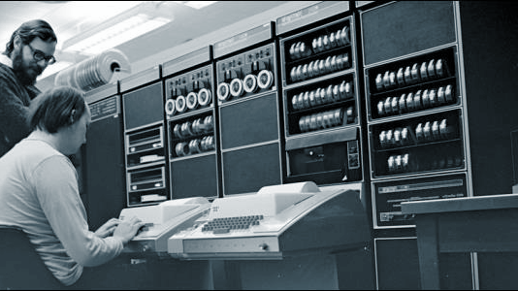

Slide 6
•Research project originally in 1965
–Joint venture between Bell Laboratories (AT&T research and development group), General Electric, and MIT
•Bell Laboratories withdrew in 1969
–Ken Thompson and Dennis Ritchie continued the project

Slide 7
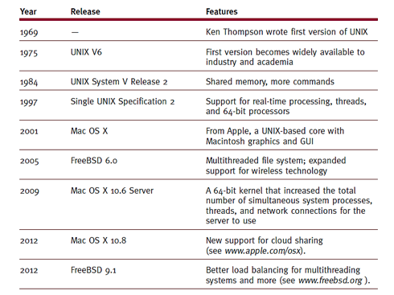

Slide 8
•Three major advantages of UNIX
–Portability
•Code written in high-level language (C language)
–Powerful utilities
•Brief, single operation commands
•Combinable into single command
–Application device independence
•Configurable to operate on any device type

Slide 9
The Evolution of UNIX
•First official version
–Design
•Do one thing well
–Ran on a popular minicomputer
–Widely adopted: competitive in the market
•Thompson and Ritchie: version 3
–New programming language (C language)

Slide 10
•AT&T forbidden to sell software
–Universities and developers advanced software
•Commercial transformation
•Berkeley “bsd” version: 1973-1975

Slide 11
•1991: “The Open Group” formed
–Owns UNIX trademark
•Key UNIX features preserved
–Expanded commands and controls: increased to meet new needs
•Standards established
–Improve program’s portability from one system to another

Slide 12
Design Goals
Thompson and Ritchie envisioned UNIX as an operating system created by programmers, for programmers. It was built to be fast, flexible, and easy to use.

Slide 13
Immediate goals were twofold:
Support software development
Included utilities for customized code
Utilities designed for simplicity: do one thing well
Small manageable sections of code
Keep algorithms simple
Based on simplicity, not speed or sophistication

Slide 14
Long-term goal
Portability
Reduces conversion costs
Application packages not obsolete with hardware changes
Achieved with UNIX version 4: device-independent
Portable Operating System Interface for Computer Environments
Known as POSIX
IEEE standards defining portable operating system interface

Slide 15
Processor Management
Processor Manager - handles allocation of the CPU, process scheduling and satisfaction of process request. Process Scheduler - selects a process from the READY queue and begins its execution for a given time slice.
The process scheduling algorithm picks the process with the highest priority to be run first.
Interactive processes typically have a low compute-to-total-time ratio, so interactive response is maintained without any special policies.
The overall effect of this negative feedback is that the system balances I/O-bound jobs with CPU-bound jobs to keep the processor busy and to minimize the overhead for waiting processes.

Slide 16
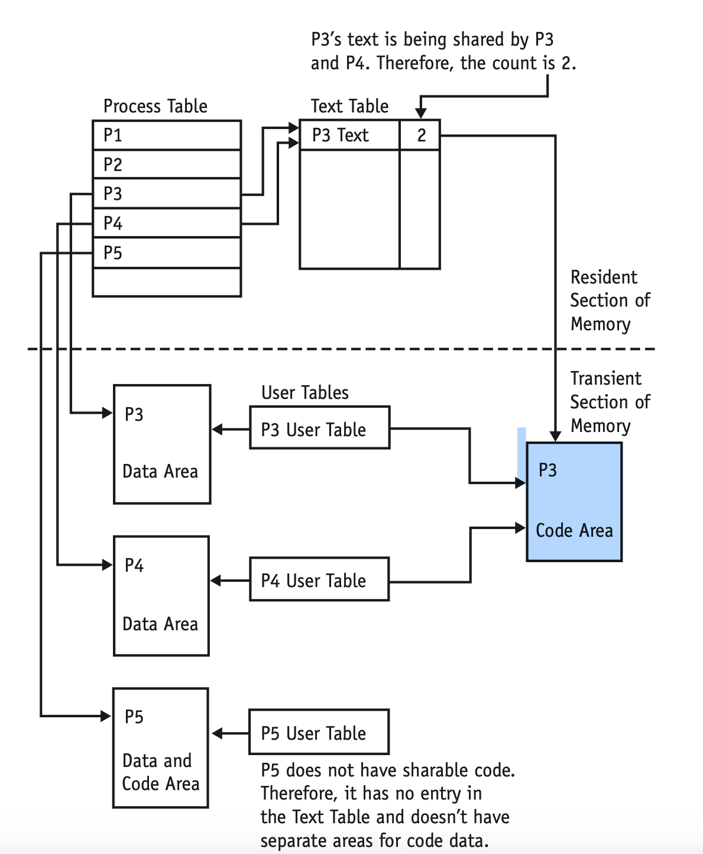
Process Management
Process Table Versus User Table
UNIX uses several tables to keep the system running smoothly.
Information on simple processes (non sharable code) is stored in two sets of tables:
Process table (always resides in memory)
User table (resides in memory only while the process is active)
Process table contains the following information:
Process identification number
User identification number
Process memory address or secondary storage address
A count to keep track of the number of processes using this code
Every time a process starts using this code, the count is increased by 1; and every time a process stops using this code, the count is decreased by 1.
When the count is equal to 0, the code is no longer needed and the table entry is released together with any memory locations that had been allocated to the code segment.

Slide 17
Process Management
User table is allocated to each active process.
This table is kept in the impermanent area of memory as long as the process is active and contains information that must be accessible when the process is running.
User table contains the following information:
User and group identification numbers
Pointers to the system’s file table for every file being used by the process
Pointer to the current directory
A list of responses for various interrupts.

Slide 18
Process Management
Synchronization
Achieves process synchronization by requiring that processes wait for certain events.
An unusual feature of UNIX is that it gives the user the capability of executing one program from another program using the fork command.
FORK COMMAND - Gives the second program all the attributes of the first program, such as any open files, and saves the first program in its original form.
When fork is executed, a “process id” is generated for the new process.
Original process is called parent process
Resulting process is child process.
A child inherits the parent’s open files and runs asynchronously with it unless the parent has been instructed to wait for the termination of the child process.
The exec family of commands—excel, execv, execle, execlp, and execvp—is used to start execution of a new program from another program.
A successful exec call will lay the second program over the first, leaving only the second program in memory.
The ls command can generate a listing of the current directory.
These system calls illustrate the flexibility of UNIX that programmers find extremely useful.

Slide 19
Memory Management
Text book define Memory Management is every operating system that need a physical memory and application program to access memory in different ways.
(it a process that control and coordinate computer memory that run program can run through the system) run a multiprogramming through the system
~For example, Windows operating system need a network in order to run a application programs for Windows
The part of a memory mangement :
Swapping ,Demanding paging

Slide 20
Swapping (small job):
The program is in the main memory before starting to do it job what the user ask for.
The program have a size limit depend on the Another swapping policy is priority based scheduling algorithm.computer memory
Another swapping policy is priority based scheduling algorithm.The round Robin policy have a schedule and set instructions it follow to do the job in certain amount of time.
Demanding paging is a operating system that more complex hardware the computer setup
Thrashing a virtual storage that mange logical storage or memory unit is call page
It has more memory is called. Virtual concepts
Demanding paging (large jobs)

Slide 21
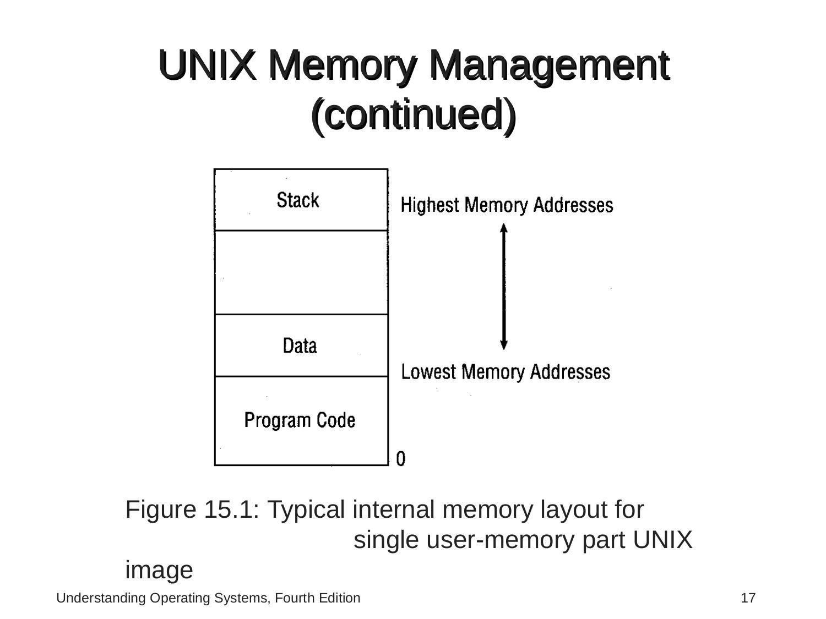
Typical Interval memory
A single user memory part image
The image show the typical internal memory computer environment
The part of the memory register values,the files status , directory.
Main memory give program code special testment
UNIX uses to track of which process code using program code and memory
Once the memory not released it doesn't need the code
The stack segment:
The main memory section where it process information saved , interrupted or temporarily storiafe
Data Segment:
After the program code and grows more memory location what the program needed
Shareable Program code:
The code physical shared to bunch of processes and written recetrant code.
Reentrant code is required to used to shared to multiple use system
.

Slide 22
Device Management
UNIX is designed to provide device independence to the applications running under it.
It treats every I/o device as a special file,and are assigned specific filename as like any other file in UNIX.
Descriptors called iodes holds all the information about all the installed devices .
Device Drivers, a subroutine that work with operating system to supervise any transmission of data between main memory and its peripheral unit.
Device drivers are incorporated into the kernel during System configuration.
UNIX has special program called config which automatically creates file name config.c for any hardware configuration.
Config.c contains two tables bdevsw (short for block device switch) and cdevsw (short for character device switch), which provide the UNIX system kernel with the ability to adapt easily to different hardware configurations by installing different driver modules.
Brief introduction

Slide 23
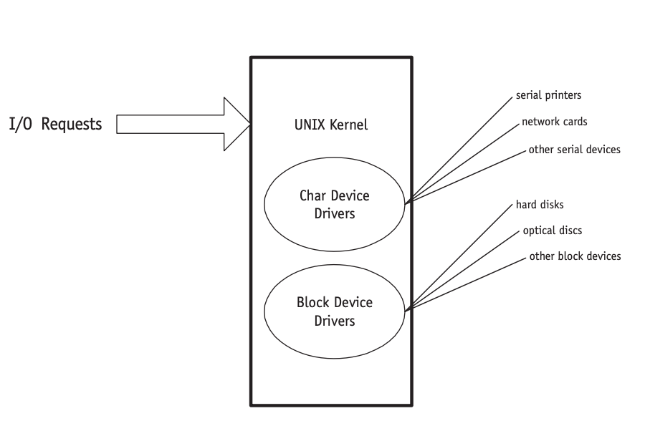
Device management continued
I/O system divided into two.
The block I/O system (sometimes called the structured I/O system)
The character I/O system (sometimes called the unstructured I/O system).
Each physical device is identified by a minor device number, a major device number, and a class—either block or character.
Device classification

Slide 24
Device cont.
This table is the only connection between the system code and the device drivers, and it’s an important feature of the operating system.
This table is the only connection between the system code and the device drivers, and it’s an important feature of the operating system. This table allows the system programmers to create new device drivers quickly to accommodate differently configured system.
The major device number is used as an index to the array to access the appropriate code for a specific device driver
The minor device number is passed to the device driver as an argument and is used to access one of several identical or similar physical devices controlled by the driver.
The block I/O system is used for devices that can be addressed as a sequence of identically sized block
This allows the Device Manager to use buffering to reduce the physical disk I/O. UNIX has from 10 to 70 buffers for I/O, and information related to these buffers is kept on a list.
Device classification

Slide 25
Cont.
Each device has a special section in the kernel which is called device driver..
Each device driver includes all the instructions necessary for UNIX to communicate with the device.
By convention all the devices files are kept in /dev directory. Even though it can be kept anywhere.
Device drivers are kept in a set of files that can be included as needed. When upgrades are made to peripherals, small changes to the device driver file can be linked into the kernel to keep the operating system apprised of the new features and capabilities
Device drivers

Slide 26
File Management
UNIX has three types of files
-Directories
-Ordinary Files
-Special Files

Slide 27
Directories
-Directories store both special and ordinary files.
-This type of files does not contain executable programs or text but a list of filenames, and directory names or other related information on file location on the storage device.
-So, the users be familiar with Unix from users using windows and MacOS, Unix directories are equivalent to folders.

Slide 28
Ordinary Files
-Are those in which users store information, which are related on user’s requests on write, read, execute, and delete functions that can be performed on a file.
-An ordinary file is a file on the system that contains data, text, or program instructions.

Slide 29
Special Files
-Are the device drivers that provide the interface to I/O (Input/Output) hardware.
Example: -CD-ROM Drives
-Ethernet Adapters
-Modems
-Commonly Special files appear as entries in directory, which each special file indicates the types of device that are associated with it.

Slide 30
File Management
-Unix stores file as sequences of bytes and doesn’t impose any structure on them. Having that said the files used in Unix are controlled by the program itself not by the system.
-The Unix file management system organizes the disk into blocks and divides the disk into four basic regions:
-First region which is reserved for booting.
-Second region which contains all the information store in the disk.
-Third region which includes a list of file definitions known as i-list.
-Fourth region holds the free blocks available for file storage.

Slide 31
File Naming Conventions
-Filenames are case sensitive, which capital names are considered differently than lower case letters. For example, in the book example of four different files in a single directory: FIREWALL, firewall, FireWall, and fireWALL.
-Unix allows file names up to 255 characters in length and most allow many special characters. However, colon(:) are not part of it. For example: backup.sh would indicate the file to be a shell program.
-Also, Unix support a hierarchical tree directory structure which the root directory is identify by a slash (/)which is used as a delimiter.
For example from the book:
/music class/Jazz 203/april 2013 Miles

Slide 32
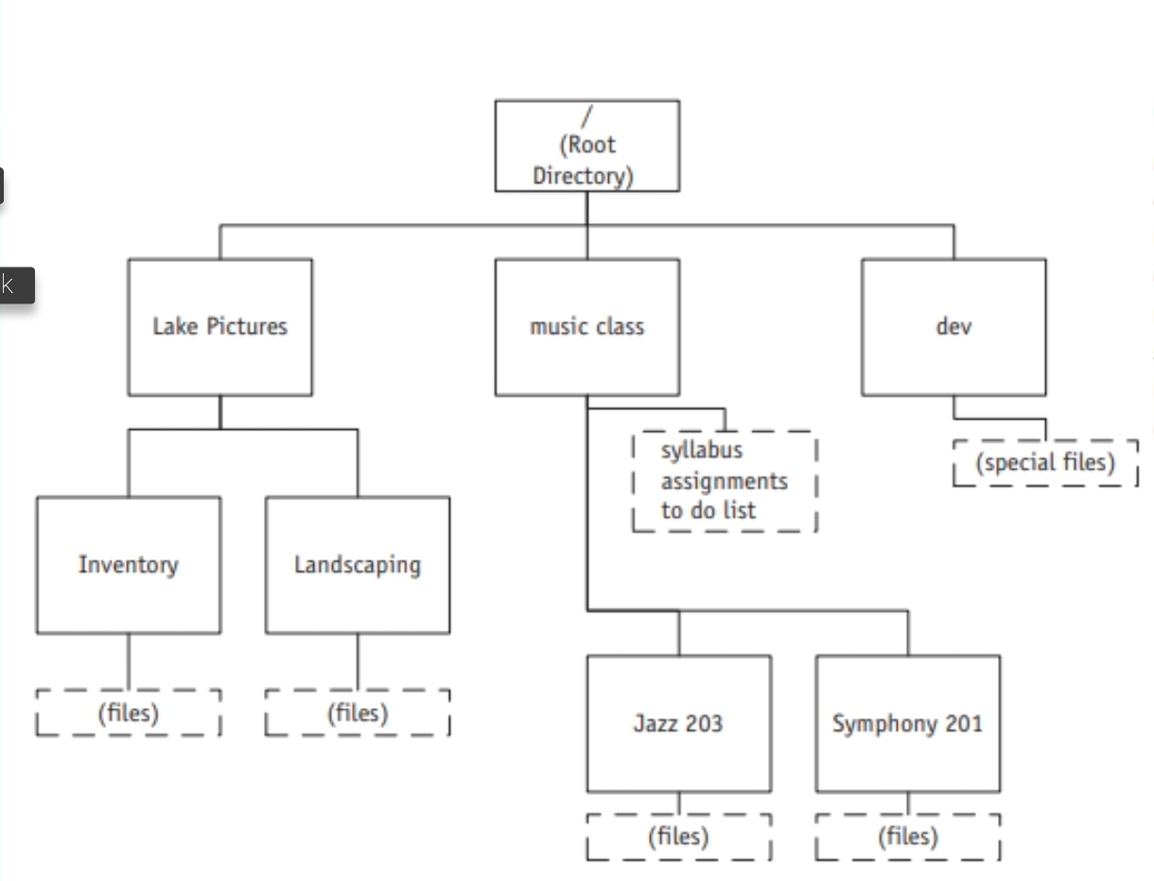
File Naming

Slide 33
Directory Listings
-The files in a directory shows eight pieces of information for each file:
-The Access Control
-The Number Of Links
-The Name Of The Group and Owner
-The Byte Of The File
-The Date & Time
-Filename

Slide 34
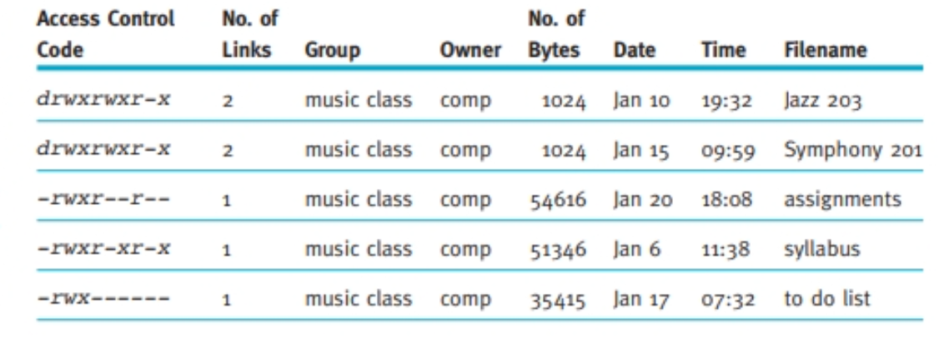
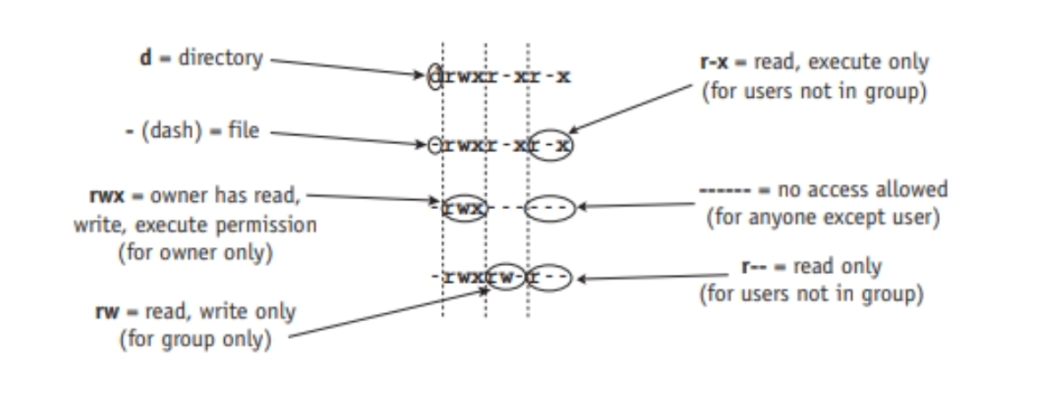
Directory Listing

Slide 35
User Interface

Slide 36
UNIX now typically supports both menu-driven systems and the traditional command-driven interfaces. Because both interfaces are nearly identical in both UNIX and Linux.
Fact

Slide 37
UNIX was created as a command-driven system and its user commands are very short:
either one character (usually the first letter of the command)
Or
a group of characters (an acronym of the words that make up the command).
In command mode, the system prompt is very economical, often only one character, such as a dollar sign ($) or percent sign (%).
command-driven system

Slide 38
Some Rules :
User commands can’t be abbreviated
expanded
must be in the correct case
Tips: Unix commands are mostly in lower Case

Slide 39
Let's Take A look at some commands of UNIx

Slide 40
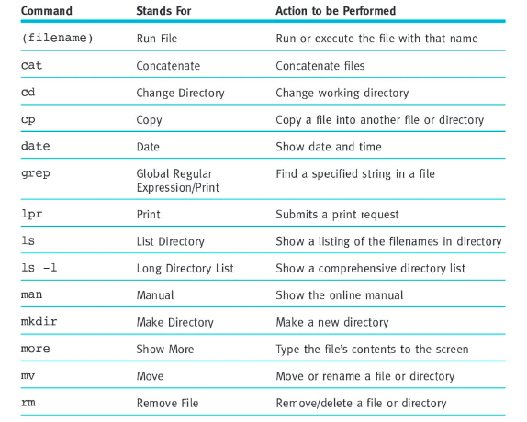

Slide 41
How do we use the command line?

Slide 42
•General syntax of commands
-command arguments file_name
Let’s Break it down

Slide 43
“Command”
The command is any legal operating system command
a command is a specific order from a user to the computer's operating system or to an application to perform a service

Slide 44
“arguments“
Required for some commands, optional for others
“file_name”
Relative or absolute path name

Slide 45
Script Files
Command files, often called shell files or script files, can be used to automate repetitive tasks. Each line of the file is a valid command; the script file can be executed by simply typing sh and the name of the script file. Another way to execute it is to define the file as an executable command and simply type the filename at the system prompt.

Slide 46
Script files are used to automate repetitive tasks and to simplify complex procedures. Here is an example of a simple script file that’s designed to configure the system for a certain user:
setenv DBPATH /u/lumber:.:/zdlf/product/central/db
setenv TERMCAP $INFODIR/etc/termcap
stty erase ’^H’
set savehistory
set history=20
alias h history
alias 4gen infogen -f
setenv PATH /usr/info/bin:/etc
In this example, the working directory paths are set, the history is set to 20 lines, and it is given an alias of h (so the user can perform the history command simply by typing h). Similarly, 4gen is established as an alias for the command infogen -f. Finally, the path is defined as /usr/info/bin:/etc.

Slide 47
Redirection
Most of the commands used to produce output are automatically sent to your screen; the editor accepts input from the keyboard. When you want to send output to a file or to another device, this is done by using the angle bracket ( > ) between the command and the destination to which the output should be directed. For example, to make a copy of the files listed in your current directory and put them in the file named myfiles (instead of listing them on the screen), use this command:
ls > myfiles

Slide 48
The double-angle-bracket symbol ( >> ) appends the new file to an existing file. Therefore, the following two commands copy the contents of chapter_1 and chapter_2onto the end of whatever already exists in the file called section_a.
“cat chapter_1 chapter_2 >> section_a”
If section_a doesn’t exist, then the file is created as an empty file and then filled with chapter_1 and chapter_2, in that order.

Slide 49
The reverse redirection is to take input for a program from an existing file instead of from the keyboard. For example, assume you have written a memo and need to mail it to several people. The following command sends the contents of the file memo to those individuals (in this case Chris, Anthony, Ida, and Roger) who are listed between the command mail and the angle bracket symbol ( < ):
mail Chris Anthony Ida Roger > memo

Slide 50
A pipe is the operating system’s way to connect the output from one program to the input of another without the need for temporary or intermediate files. A pipe is a special type of file connecting two programs; information written to it by one program may be read immediately by the other, with synchronization, scheduling, and buffering handled automatically by the system. In other words, the programs execute concurrently, not one after the other. By using the vertical pipe symbol ( | ), the last example can be rewritten as:
who | sort
Pipeline
Several programs simultaneously processing same I/O stream
Example: who | sort | lpr
Pipes

Slide 51
UNIX has many programs that read some input, manipulate it in some way, and generate output; these programs are called filters.
wc (word count):
Example: wc journal
System response: 10 140 700
File journal has 10 lines, 140 words, 700 characters
sort
Command with filename given: contents of file sorted and displayed on screen
Example: sort wk_names > sortednames
Input file sorted and written to another file
Filters

Slide 52
More Filters Commands
Obtain numerical sort in ascending order
sort -n wk_names > sortednumbs
Obtain numerical sort in descending order
sort -nr wk_names > sortednumbs
Obtain sort on the third field in alphabetical order
sort +2f empl > sortedempl

Slide 53
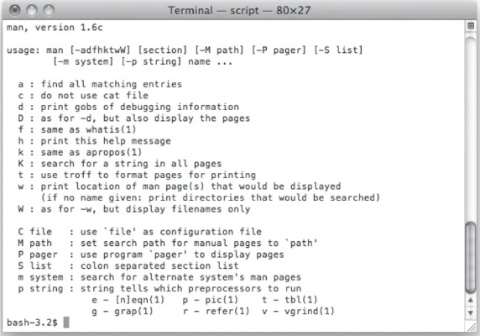
Additional commands

Slide 54
man
Displays operating system online manual
Example: man cmp
Displays page for compare (cmp) command
Nohup
Log off the system without program completion
Example:
nohup cp old_largefile new_largefile &
Nice
Allows lowering program priority
Example:
nice cp old_largefile new_largefile &

Slide 55
Grep
–“global regular expression and print”
–Look for specific character patterns
–Examples:
•grep Pittsburgh mail-list
•grep -v Pittsburgh mail-list
•grep -c Pittsburgh mail-list
–Can be combined with who command
–Example: who | grep bob
•Bob’s name, device, date and time he logged in
–Example: ls -l / | grep '\d'
•Displays subdirectories list (not files) in root directory

Slide 56
Conclusion
The impact of UNIX on the computing world has been far reaching. Its power, speed, and flexibility, along with its widespread adoption on computing devices of every size, has helped it revolutionize the development of operating systems. It is no surprise that a very similar operating system, Linux, has also been met with enthusiasm. Together, they run on many millions of computers and computing devices.

Slide 57


